Slide 1

Object-Oriented Programming Discussion, Lecture, & Lab Eric Pogue
Agenda for Monday, September 30th from 2 to 2:50pm CST:
Friendly Conversation Topic – Self-Improvement and Working with Teams
Assignment from Last Class
Discussion of Graphical User Interfaces (GUI) in Java
Assignment for Next Class
Lab: FaceDraw, FaceDraw, FaceDraw
Discussion & Questions welcome at any time… please be present with no phones or email during our time together

Slide 2
Self-Improvement and Working with Teams
Notes:
https://www.uline.jobs/JobSearchResults?culture=en&department=information%20technology&sort=Department-asc
Starting at 3pm in 106A

Slide 3
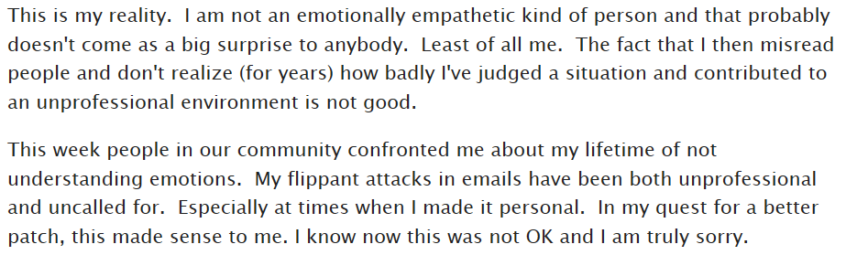
Who is the Author

Slide 4

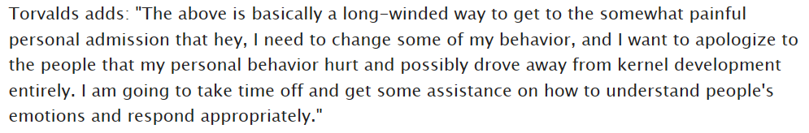
Answer

Slide 5
Suggested Reading: Dale Carnegie

Slide 6
Notes:
Optimism & Good-natured Humor

Slide 8
Assignment
Complete Activities List items through item 6 and be prepared to discuss them at the start of our next class. Plus have a solid start on item 7.
Prepare to discuss one GUI topic in our next class.

Slide 9
Discussion of Graphical User Interfaces (GUI) in Java
Summarize Java Graphical User Interface Development
Position Java GUI development
Explain Heavyweight components
Explain Lightweight components
Examine the paint and paintComponent methods
Explain Layout Managers
Review Class extension
Introduce Interface implementation
Introduce Event Handling
Examine an implementation of ActionListener
Notes:
Heavyweight AWT override Paint
Lightweight and Swing override PaintComponent
GUI programming and threading

Slide 10
Assignment
All sprint 3 activities and assignments need to be complete Sunday

Slide 11
Lab
As A Scrum Team:
FaceDraw, FaceDraw, FaceDraw
Team report out by new Scrum Master at 2:48
Team Report Out Guidelines
Scrum Master will stand up, give your name, your team name, and briefly answer the following questions:
What did you accomplish since the last meeting? And what will you be working on until the next meeting?
Is the team committed to completing assignments? All/Most/Some
What is getting in your way or keeping you from completing the assignments?

Slide 12
End of Session

Slide 13
Self-Improvement and Working with Teams … Or Uline
Notes:
https://www.uline.jobs/JobSearchResults?culture=en&department=information%20technology&sort=Department-asc
Starting at 3pm in 106A

Slide 14
Who is the Author

Slide 15
Answer

Slide 16
Suggested Reading: Dale Carnegie

Slide 17
Notes:
Optimism & Good-natured Humor

